Slide 1
Frames in html
Ms. Vinitha S Ganiga
Assistant Professor
Dept. Of Computer Science

Slide 2
HTML frames
HTML frames are used to divide your browser window into multiple sections where each section can load a separate HTML document.
A collection of frames in the browser window is known as a frameset.
The window is divided into frames in a similar way the tables are organized: into rows and columns.

Slide 3
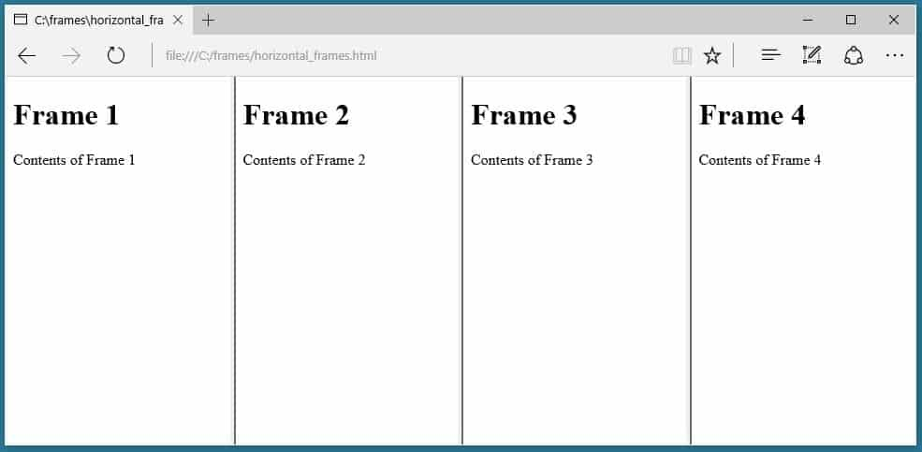
VERTICAL FRAMES

Slide 4
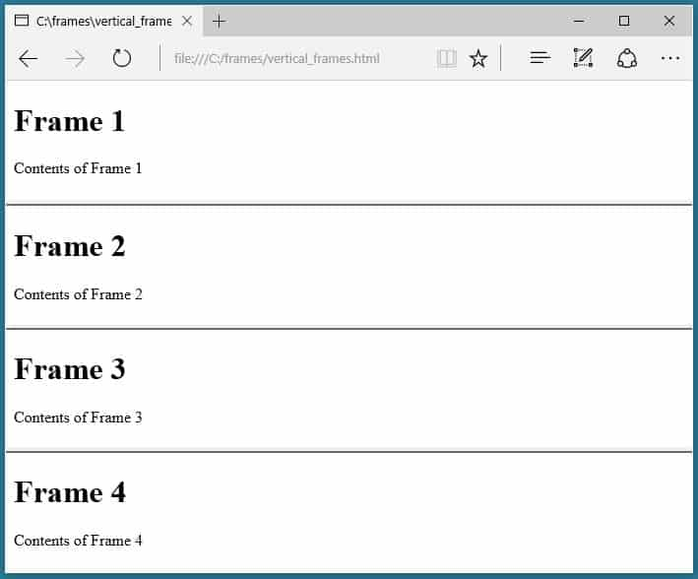
Horizontal FRAMES

Slide 5
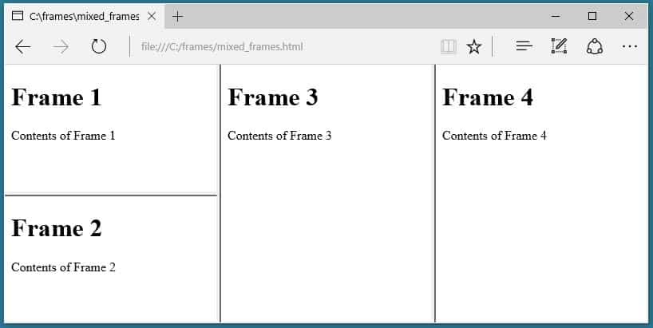
Mixed FRAMES

Slide 6
Creating Frames
To use frames on a page we use <frameset> tag instead of <body> tag.
The <frameset> tag defines, how to divide the window into frames.
The rows attribute of <frameset> tag defines horizontal frames and cols attribute defines vertical frames.
Each frame is indicated by <frame> tag and it defines which HTML document shall open into the frame.

Slide 7
The <frameset> Tag Attributes
Attributes | Description
cols | Specifies how many columns are contained in the frameset and the size of each column. To create three vertical frames, Absolute values in pixels. For example, use cols = "100, 500, 100". A percentage of the browser window. cols = "10%, 80%, 10%". Using a wildcard symbol. cols = "10%, *, 10%". In this case wildcard takes remainder of the window.
rows | This attribute works just like the cols attribute and takes the same values, but it is used to specify the rows in the frameset. For example, to create two horizontal frames, use rows = "10%, 90%".

Slide 8
The <frameset> Tag Attributes
Attributes | Description
border | This attribute specifies the width of the border of each frame in pixels. For example, border = "5". A value of zero means no border.
frameborder | This attribute specifies whether a three-dimensional border should be displayed between frames. This attribute takes value either 1 (yes) or 0 (no). For example frameborder = "0" specifies no border.
framespacing | This attribute specifies the amount of space between frames in a frameset. This can take any integer value. For example framespacing = "10" means there should be 10 pixels spacing between each frames.

Slide 9
The <frame> Tag Attributes
Attributes | Description
src | This attribute is used to give the file name that should be loaded in the frame. Its value can be any URL. For example, src = "/html/top_frame.htm" will load an HTML file available in html directory.
frameborder | This attribute specifies whether or not the borders of that frame are shown; this can take values either 1 (yes) or 0 (no).
scrolling | This attribute controls the appearance of the scrollbars that appear on the frame. This takes values either "yes", "no" or "auto". For example scrolling = "no" means it should not have scroll bars

Slide 10
The <frame> Tag Attributes
Attributes | Description
name | This attribute allows us to give a name to a frame.
marginheight | This attribute allows us to specify the height of the space between the top and bottom of the frame's borders and its contents. The value is given in pixels. For example marginheight = "10".
marginwidth | This attribute allows us to specify the width of the space between the left and right of the frame's borders and the frame's content. The value is given in pixels. For example marginwidth = "10".
noresize | By default, we can resize any frame by clicking and dragging on the borders of a frame. The noresize attribute prevents a user from being able to resize the frame. For example noresize = "noresize".

Slide 11
Creating Vertical frames
<html>
<head>
<title>frames in html</title>
<frameset cols="30%,20%,40%,*">
<frame src="1.html">
<frame src="2.html">
<frame src="3.html">
<frame src="4.html">
</frameset>
</head>
</html>

Slide 12
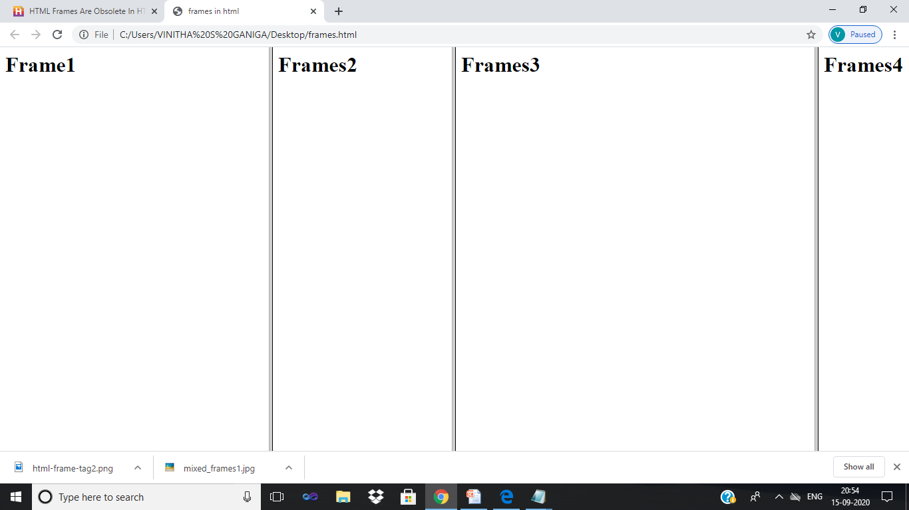

Slide 13
Creating horizontal frames
<html>
<head>
<title>HTML Frames</title>
</head>
<frameset rows = “20%,60%,20%">
<frame name = "top" src =“fram1.html” />
<frame name = "main" src =“fram2.html” />
<frame name = "bottom" src =“fram3.html” />
</frameset>
</html>

Slide 14
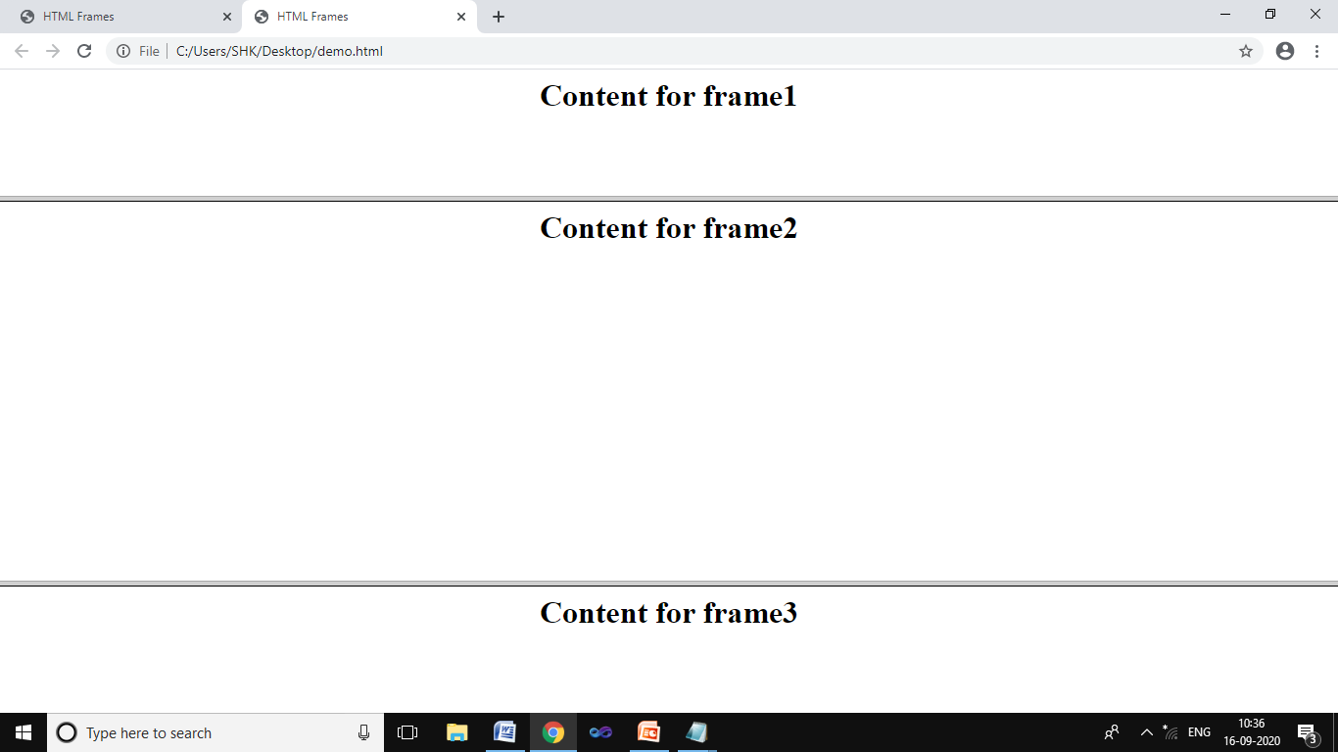
Creating horizontal frames

Slide 15
<html>
<head>
<title>HTML Frames</title>
</head>
<frameset rows = "20%,60%,20%">
<frame name = "top" src= "fram1.html" marginwidth="200" noresize="noresize"/>
<frame name = "main" src="fram2.html" marginheight ="50" />
<frame name = "bottom" src="fram3.html"/>
</frameset>
</html>

Slide 16
Mixed FRAMES

Slide 17
Creating the mixed frameS
<html>
<head>
<title>mixed frame</title>
</head>
<frameset cols="30%,30%,*">
<frameset rows ="50%,*">
<frame src="fram1.html"/>
<frame src="fram2.html"/>
</frameset>
<frame src="fram3.html"/>
<frame src="fram4.html"/>
</frameset>
</html>

Slide 18
fram1.html <html> <body> <h1>Frame1</h1> <p>Content for frame1</p> </body> </html> | fram2.html <html> <body> <h1>Frame2</h1> <p>Content for frame2</p> </body> </html>
fram3.html <html> <body> <h1>Frame3</h1> <p>Content for frame3</p> </body> </html> | fram4.html <html> <body> <h1>Frame4</h1> Content for frame4 </body> </html>

Slide 19
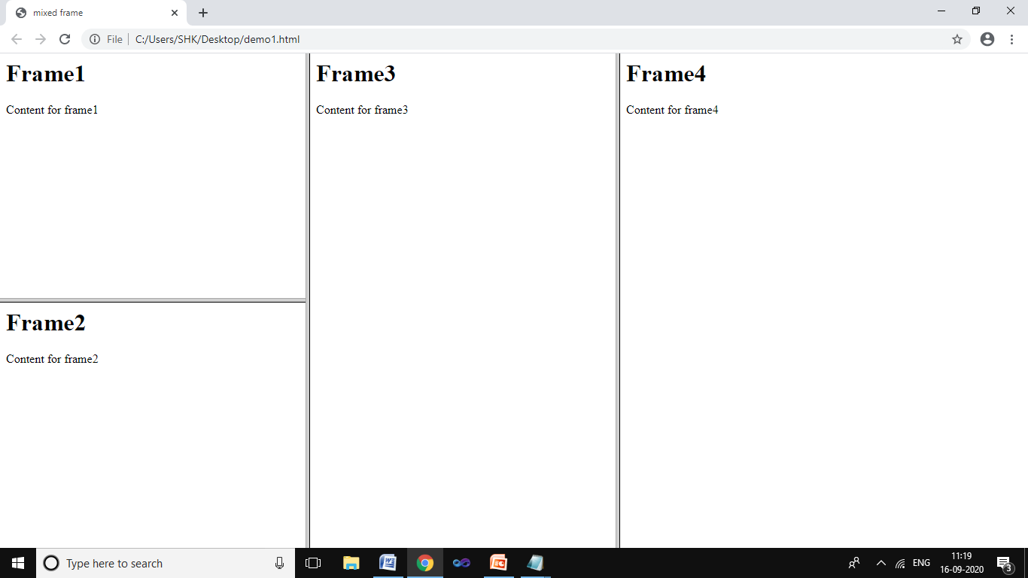

Slide 20
MIXED FRAMES
<html>
<head>
<title>mixed frame</title>
</head>
<frameset cols="50%,*">
<frame src="fram1.html"/>
<frameset rows ="30%,30%,*">
<frame src="fram2.html"/>
<frame src="fram3.html"/>
<frameset cols="50%,50%">
<frame src="fram4.html"/>
<frame src="fram5.html"/>
</frameset>
</frameset>
</frameset>
</html>

Slide 21
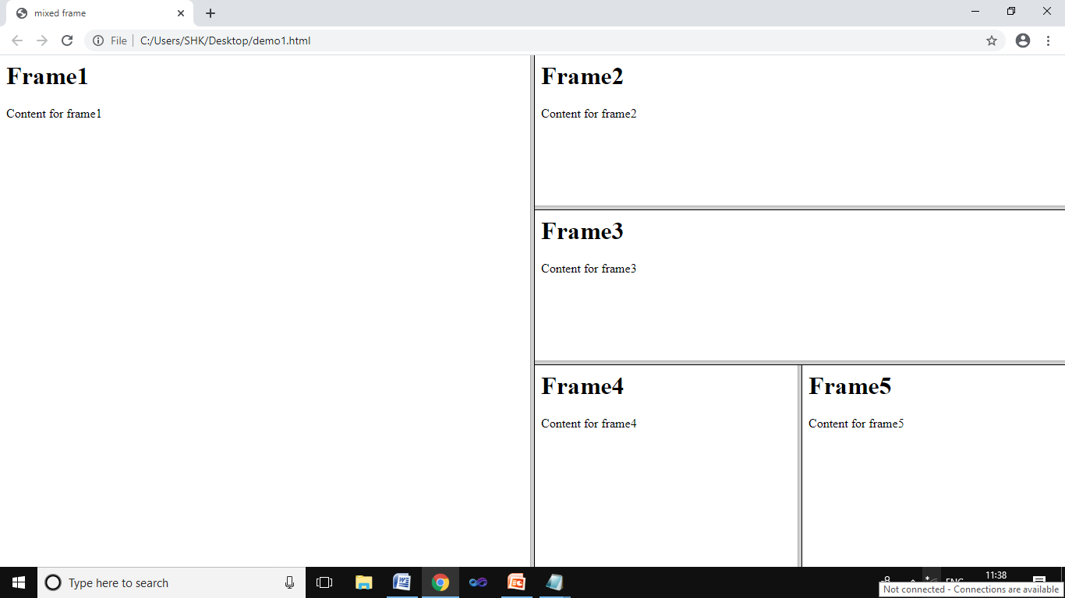

Slide 22
THANK YOU

